Slide 1
Welcome to Ski Rules Meeting
Intent of meeting:
Cover MHSAA rule changes
Review previous changes
Reminders for the 2013-14 season
Reminders for post season

Slide 2
Athletic Eligibility
The current MHSAA Handbook,
Regulation I, Essential Eligibility Requirements for Senior High School Students, is applicable to member school ski teams.
Please consult with athletic director.

Slide 3
MHSAA Concussion Protocol Review
Role of official is to point out potentially concussed athlete to coach
Coach makes decision to remove athlete from play
School designated health care professional makes sideline determination to return or remove athlete from game
Notes:
For the past two years, game playing rules and MHSAA rules have been in place addressing how to handle an apparently concussion athlete. The protocols in detail can be downloaded from this presentation or from the MHSAA Website. Here’s a quick review of the highlights of those protocols:
First, officials have no role in determining whether or not an athlete stays or is removed from the game. The official’s role is to advise the coach of the possible concussion.
The school, which has the primary responsibility for the well-being of the athlete, makes the determination to remove the youngster from the game, and after the its designated health care professional evaluates the situation, makes the determination to return or withhold the player from the competition.

Slide 4
MHSAA Concussion Protocol Review
Once removed, athlete is finished for that day of competition
Return to play only on a subsequent day by written authorization of MD or DO
Penalties for unauthorized return
Notes:
Once the determination is made to withhold the player from further play, the athlete may not return to competition that day and may not return on a subsequent day without the written authorization of the MD or a DO. Schools which play athletes which have not been properly cleared to return are subject to MHSAA Handbook penalties.

Slide 5
Concussion Education – Get More!
Download from this presentation:
Signs & Symptoms Information
MHSAA Concussion Protocol
Take the online course for coaches, athletes & parents:
MichiganNeuroSport.com
Notes:
It takes a team to keep concussions on the sidelines and kids in the game. We encourage everyone to become more aware about the signs and symptoms of concussions, and in partnership with the University of Michigan NeuroSport and the Brian Injury Association of Michigan, we have a number of resources you can download from the attachments tab at the top of the screen to share with your coaches, players and parents.
We also encourage you to take a few minutes and visit the NeuroSport website, where you can view a free online concussion education program. There are versions of this program for athletes and parents as well, so we hope you’ll download the attached flyer promoting the program and distribute it to everyone before the season starts.

Slide 6
Reminders
Go to the MHSAA web site and download the Ski Coaches Manual
www.mhsaa.com , click on ski, go to Coaches Box
Work with your athletic director on student eligibility and sport regulations.

Slide 7
FAQ’s
Each qualifying team shall provide two workers (ski qualified) for both morning and afternoon events. This shall be applied to each male team and each female team.
Bibs – Each skier must wear the bib and bib number assigned to them. AFTER the meet, the individual must return the bib to host management. There is a $50 fee charged for all lost bibs.
Regional Meet – this year, the regional meet may be scheduled on any day, Monday-Friday, the week of February 10-14.

Slide 8
FAQ’s
To be eligible to enter the Regional Ski Meet, the team must enter and ski a minimum of four skiers in each discipline.
To be eligible for post season, a team must compete in four meets against MHSAA member schools.
An individual must have competed in at least four meets with his/her school team against other MHSAA member schools.

Slide 9
Contest Limitations
No team schedule or individual may exceed 15 days of competition.
Each school team is allowed four scrimmages – no more than 2 prior to first contest.
A competitor may enter a maximum of two non-school meets (LTM).
Each skier must have a Physical Form and CUSSA/High School Meet schedule on file with school administration and MHSAA prior to competition.

Slide 10
Contest Limitations
Continued-
Each skier must have a Physical Form and CUSSA/High School Meet schedule on file with school administration prior to competition.
At this time, we have not identified a CUSSA Rep (to collect forms) so each CUSSA Meet schedule – per skier must be sent to the MHSAA office as well.
Fax: 517.332.4071

Slide 11
Helmets
Each racer must have a helmet which completely covers the head (no soft ears) and is manufactured for ski racing.
All slalom racers must have a mouth guard/jaw guard on their helmet.
Coaches and athletes need to be aware of and consider the value of supplemental equipment (ie shin guards, body armor).

Slide 12
Important Dates
First allowable dates for:
Practice – November 18
Competition – December 14
Entry – February 7

Slide 13
Important Post Season Dates
Regional – the week of February 10-14
Final – February 24
Weather postponement - the postponed competition may be made up at the site or alternate site any day following the originally scheduled day (regional - no later than Wednesday prior to the Final).

Slide 14
Review of Previous Rule Changes
Eliminate the outside gates for slalom
Outside gates are required only in the following circumstances:
Start and Finish
First and last gate
All combinations (flushes and hairpins, including the exit gate)
All through and delay gates

Slide 15
Review of Previous Rule Changes
Eliminate outside gates for GS
Outside gates are required only in the following circumstances:
Start and finish
First and last gate
Any through gate, delay gate, or corridor which does not require a direction change.

Slide 16
Review of Previous Rule Changes
All disqualifications must be noted or
posted on the unofficial result board for
each run within 15 minutes of the last
competitor’s run in that discipline.

Slide 17
Review of Previous Rule Changes
Schedule Option (Regional and Final) - The meet manager has the option of skiing the entire first run then start the second run. Skiers may be required to inspect both courses prior to the first run. (If you do not reset the course, there will be an immediate changeover to the second run.)

Slide 18
Review of Previous Rule Changes
Course Setting
At the Regional level, participating schools will be represented in the course setting.
At the Final level, each region shall be represented provided qualified personnel are available.

Slide 19
Review of Previous Rule Changes
Jury Composition
(1) Referee
(2) Technical Delegate
(3) Chief of Race

Slide 20
Review of Rule Changes
At the MHSAA Final:
All individual qualifiers shall race in flights 2.5 and 4.5 with equal distribution in each flight. In the event there is an odd number of skiers, the additional skier shall be placed in 4.5.

Slide 21
Region Sites – Division 1
Region 1 – Marquette Mountain
Region 2 – Pine Knob
Region 3 – Alpine Valley

Slide 22
Region Sites – Division 2
Region 4 – Schuss Mtn
Region 5 – Cabrefae
Region 6 – Cannonsburg

Slide 23
Final Sites
Division 1 – Schuss Mountain
Division 2 – Nub’s Nob

Slide 24
Entry Reminders
The entry due date is February 7. The running order, M.E and other materials must be received by the manager by this deadline.
The Regional Manager may require additional paperwork with the entry (release form or worker’s list).

Slide 25
Scoring
The best time shall be awarded one point, the second best time two points, the third best time three points, and so forth, with all competitors who DQ, DNS or DNF to receive points equal to one greater than the total number of participants (those who were entered) in that event.

Slide 26
Scoring (con’t)
Team scores in each event shall be computed by combining the race points of the top four finishers in each event from each team competing.
Points shall be awarded as described in previous slide.

Slide 27
Scoring (con’t)
The fifth place finisher’s score in both events will be used to break a tie.
In the event of a tie of times for a position, the two times involved shall divide the total points for the two positions involved.

Slide 28
Final Meet Participants
The first, second and third place boys and girls teams from each Regional Meet will
advance to the Final Meet.
The top ten individuals in each discipline or the top four individuals not on a qualifying team (whichever is greater) will advance to the Final Meet.

Slide 29
Meeting Complete
Go to the MHSAA web site and download the Ski Coaches Manual
Review the Concussion information on the MHSAA web site
Work with your athletic director on both MHSAA eligibility regulations and ski rules.
Enjoy the season!

Slide 30
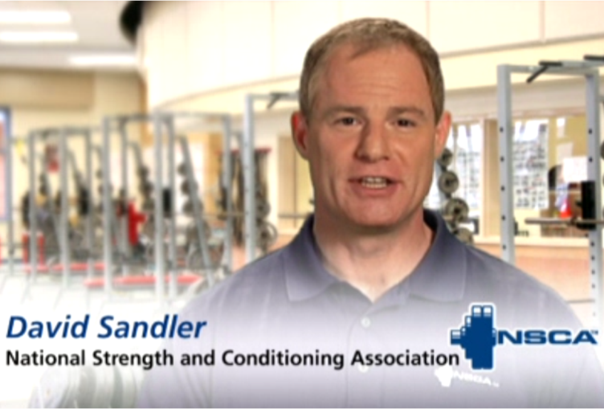
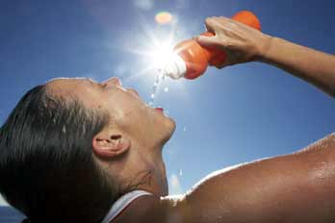
New Courses at nfhslearn.com!
Creating a Safe and Respectful Environment
Addresses hazing, bullying and cyber bullying, inappropriate relationships and social media
Strength and Conditioning
Content from NSCA, designed to educate coaches to how to properly train students
A Guide to Acclimitization and Heat Illness Prevention
Available now at www.nfhslearn.com!
FREE!
Notes:
The NFHS has recently launched three new courses. Take a few minutes and visit nfhslearn.com for a complete listing of all available courses, including our free course “A Guide to Acclimitization and Heat Illness Prevention.”

