Slide 1
THE REVISED 2016 NFHS ONLINE SANCTIONING PROCESS
FOR APPLYING FOR NFHS SANCTIONING FOR ATHLETIC EVENTS

Slide 2
The Philosophy of Sanctioning
Interscholastic athletic programs should serve educational goals. To this end, schools have an obligation to conduct inquiries about events in which their students may participate.
In order to perform their “inquiry and oversight” functions fairly and efficiently, the NFHS has developed event – sanctioning procedures in support of our member state associations on behalf of their member schools.

Slide 3
The Rationale of Sanctioning

Slide 4
The Rationale of Sanctioning
These specific purposes include the following:
  Sanctioning enhances the likelihood that events will adhere to reasonable and detailed criteria which meets the specific requirements of a state association.
  Sanctioning serves to promote sound regulation of the conditions under which students and teams compete.
  Sanctioning is a means of encouraging well-managed rules and regulations.

Slide 5
The Rationale of Sanctioning (continued)
  Sanctioning adds an element of “due diligence” that encourages compliance with state associations’ rules and regulations.
  Sanctioning protects the welfare of the student-athletes.
  Sanctioning protects the existing programs sponsored by member schools and thereby promotes the opportunity for larger number of student-athletes to gain the benefits of interscholastic competition.

Slide 6
The Rationale of Sanctioning (continued)
  Sanctioning helps reduce the abuses of excessive competition.
  Sanctioning promotes uniformity in obtaining approval for events.
  Sanctioning helps protect students from exploitation.
  Interstate and International sanctioning at the NFHS level promotes financial transparency and equivalency of treatment of participating high schools.

Slide 7
What types of events require NFHS sanctioning approval?

Slide 8
What Events Require NFHS Sanctioning?
Any interstate or international event involving two (2) or more schools which is co-sponsored by or titled in the name of an organization outside the school community (e.g., a college/university, a theme park, a service organization (Kiwanis, Optimist) or an athletic shoe/apparel company)
Events in non-bordering states if five (5) or more states are involved
Events in non-bordering states if more than eight (8) schools are involved

Slide 9
What Events Require NFHS Sanctioning?
Any event involving two (2) or more schools that involves a team from a foreign country. The host school should complete the international sanction application. This would include any event(s) that involves international traveling teams that play in multiple games in multiple states. (The exceptions to this rule are Canada and Mexico which are considered "bordering states to every U.S. state.")

Slide 10
Frequently Asked Event Eligibility and Host School Questions

Slide 11
Frequently Asked Questions?
Do international events have to be sanctioned?
  Yes, as long as it meets one of the criteria in slides #8 and # 9.
Do they have to pay a sanction application processing fee? They did not have to do so in the past.
  Yes, international sanctions require the same amount (if not more) work and our member state associations have requested more information regarding these events.

Slide 12
Frequently Asked Questions?
What if every high school in the United States is invited to participate in the Universal Runners Invitational?
  The event sponsor would have to provide the list of invited schools with the initial sanction application and a final list of attendees twenty (20) days prior to the date of the event or be subject to the late processing fee charge.

Slide 13
Frequently Asked Questions?
What is an event sponsor/manager?
  An event sponsor/manager is a person, company, club, or school (either a high school or college/university) who is looking to conduct an athletic event in a particular state.
How does an event sponsor begin applying for conducting an event?
  They must first register online at www.nfhs.org, click on “Resources” on the top Navigation bar, click on “Sanctioning” in the drop down menu, and fill out the online event manager application. See slides #20 and #22.

Slide 14
Frequently Asked Questions?
What is the “host school” and its role?
  The host school is the local member high school that assumes oversight responsibility for the event.
  It is expected that the host school’s principal monitors the event by being either present onsite during the event, or by designee.

Slide 15
Frequently Asked Questions?
What is the “Final List” of invited schools?
  Once sanctioning applications are received and approved initially by the host state association, the event manager/sponsor should upload a list of invited schools with the school name, address and state. It is the responsibility of the event manager/sponsor to forward a “final list” of invited schools twenty (20) days prior to the event in case of any changes to the original list of invited schools.

Slide 16
Frequently Asked Questions?
How is the Host School Principal notified that they are the host school?
  It is the obligation of the event sponsor/manager to secure the approval of the host school’s principal prior to listing them on the sanctioning application.
  The host school principal will receive an e-mail explaining that their school has been designated as the host school responsible for a future athletic event.

Slide 17
Frequently Asked Questions?
Can a host school be responsible for an event outside of that state (e.g. New York high school signing off as the host school for a Florida event) ?
  Yes, as recently as the 2016 January NFHS Board of Directors meeting, the policy has changed. The host school does not have to be in the same state of the event. However, when that opportunity presents itself, the residential state association has the ability to deny the event. (See Slide #18)

Slide 18
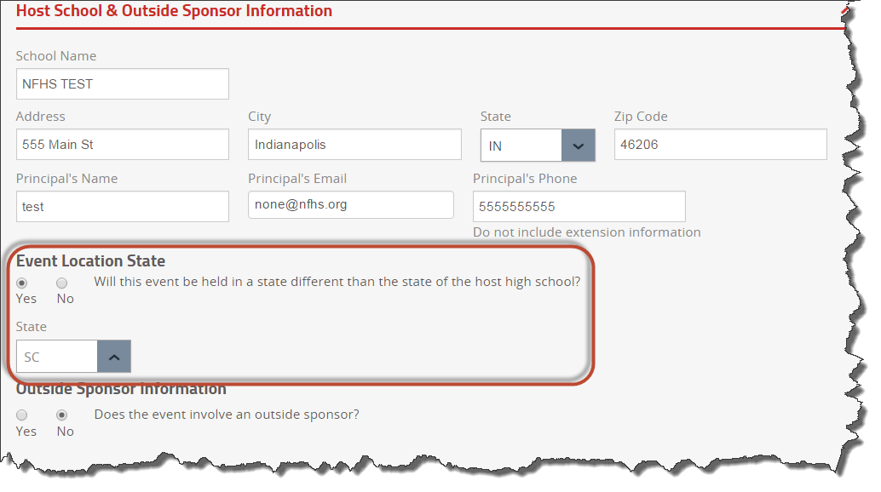
Frequently Asked Questions?

Slide 19
Frequently Asked Event Manager/Sponsor Registration Questions

Slide 20
How does an event manager/sponsor begin the sanctioning process?
All managers/sponsors will have to register in order to be able to apply for a NFHS sanction approval. See slide #21 for the event manager registration screenshot.
The event manager/sponsor will fill out the online sanctioning application 60 days or more prior to the event start date.
The event manager/sponsor will submit the sanctioning application online and it will be forwarded to the host state association office of the host school and the host school’s principal.

Slide 21
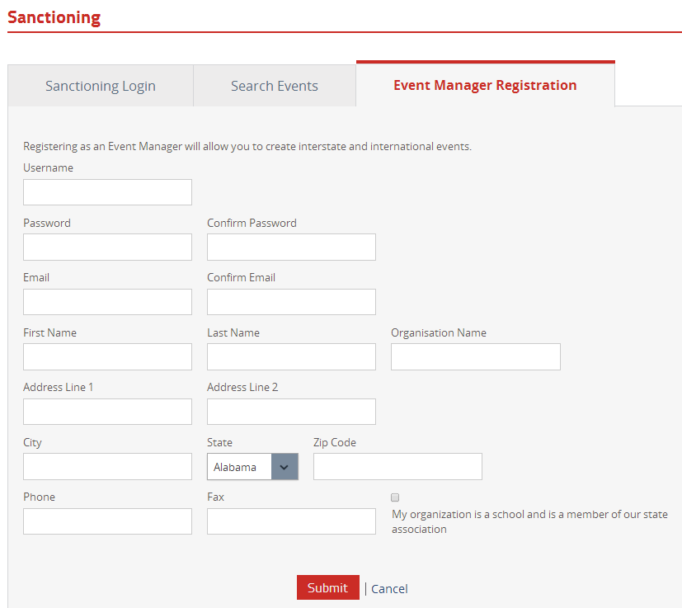
Registration Page for Event Managers/Sponsors
To begin the Sanctioning process, all event managers/sponsors have to fill out a registration page in order to go back and make any edits.

Slide 22
How does the sanctioning process continue?
The host state association reviews the event online and either accepts or rejects the sanction based on their eligibility rules (see next slide (#23) for screenshot).
  If the state association rejects the event then the event manager/sponsor is automatically notified via an e-mail.
  If the state association approves the application then the event manager/sponsor is automatically notified that payment is required and the list of invited schools and their state(s) should be uploaded.

Slide 23
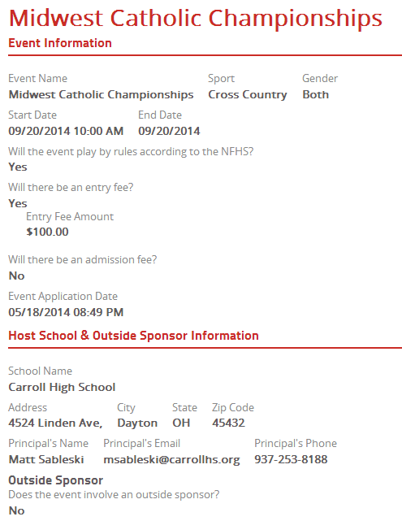
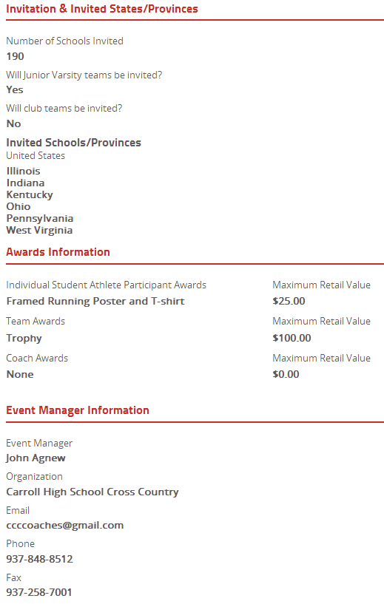
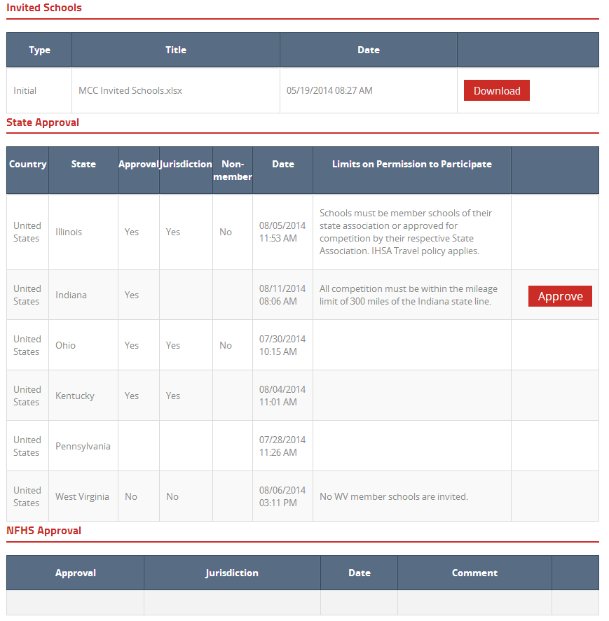
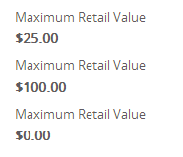
Screenshot of what the host state association sees when an event manager/sponsor forwards a new sanction event request.

Slide 24
Sanctioning Application Fee Process Information

Slide 25
What is the Sanctioning Application Fee Schedule for state association member schools?
$100 if the application is received 60 days or more prior to the event date
$200 if application is received 59-15 days prior to the event date ($100 application fee plus $100 penalty)

Slide 26
What is the Sanctioning Application Fee Schedule for state association member schools?
(continued)
$200 penalty if the application is received less than 15 days prior the event date plus an additional $100 penalty for not forwarding the list of invited schools 20 days prior to the event date for a total of $300 ($100 application fee plus $200 penalty)

Slide 27
What is the Sanctioning Application Fee Schedule for non-school organizations?
$200 if the application is received 60 days or more prior to the event date
$300 if application is received 59-15 days prior to the event date ($200 application fee plus $100 penalty)

Slide 28
What is the Processing Fee Schedule for non-high school organizations?
(continued)
$300 penalty if the application is received less than 15 days prior the event date plus an additional $100 penalty for not forwarding the list of invited schools 20 days prior to the event date for a total of $600 ($200 application fee plus $400 penalty fees)
  *Please note: Failure to declare that an event sponsor is a non-school organization will potentially damage the eligibility of the participating NFHS member schools' athletes.

Slide 29
How is the sanctioning application fee payment made ?
The sanction application fee payment will only be accepted by credit card or electronic check. The list of invited schools/states will not be forwarded or appear on the NFHS website until the payment is made.
Master Card, Visa and American Express are the only credit cards accepted for payment.

Slide 30
Frequently Asked Payment Questions

Slide 31
Frequently Asked Questions?
What if I can only pay by purchase order?
  The NFHS does not accept purchase orders.
  We recommend several alternatives:
    Any event sponsor/manager who has to use a purchase order, should submit the requisition to their school administration early enough so they can use the convenience of the electronic check feature and this does not affect the sanctioning process.
    The event sponsor/manager should use a personal credit card or personal check and receive reimbursement from their school.
    A receipt can be generated online at the request of the event manager.

Slide 32
Frequently Asked Questions?
When is the list of invited schools due to the NFHS?
  The initial list is due at the time of applying for sanctioning. The final list of invited schools is due twenty (20) days prior to the event date. If the final list of schools is not submitted then a $100 penalty is assessed. The manager/sponsor will be automatically emailed a reminder notice regarding the final list 25 days prior to the event start date.
    If the final list of invited schools is not received then the event loses sanctioning approval.

Slide 33
Frequently Asked Process and Approval Questions

Slide 34
Frequently Asked Questions?
What format can the event sponsor/manager submit their list of invited schools?
  They will be able to submit Excel, Word files as well as PDF and CSV formats.

Slide 35
Frequently Asked Questions?
What if an event sponsor/ manager finds out at the last moment that an NFHS sanction approval is required for an event?
  They will be required to go through the online process and we suggest that they place a call to the NFHS Sanctioning Department (317) 972-6900 for assistance Monday-Friday, 8:00 a.m.- 4:30 p.m. EST. to advise us that their event is a rush priority and we will closely monitor and assist the event’s processing with the involved state associations.

Slide 36
Frequently Asked Questions?
What if the event manager needs to make a change or replace a school from the same or different state?
  The event manager can make changes and additions of other school(s) online. All invited states are automatically notified of any modification via email.
  However, once an event is receives final sanctioning approval from the NFHS, the event manager will not be able to make any changes to the event and should contact the NFHS Sanctioning Department staff.

Slide 37
Frequently Asked Questions?
How does the event sponsor/manager know if an invited school is a state association member school?
  We would recommend that they contact that invited school’s state association to determine their status. Their answer will impact if other schools can compete against them.

Slide 38
Frequently Asked Questions?
What if the State Association person is out of the office when I submit my application for sanctioning and their return causes me to have to pay a late penalty fee?
  The date that the application is submitted establishes the timeline until the event begins. It also determines how much the sanctioning application fee will be expected for payment. If the state association sanctioning coordinator if out of the office or not available, you will not be penalized.

Slide 39
Frequently Asked Questions?
How do I know if invited states have approved their schools to participate?
  The invited state associations will receive weekly automatic e-mail reminders that they have outstanding requests and a response is required.
  Once the invited state(s) responds it will be updated on the NFHS website with any additional comments. See slides #40 & #41 for screenshots of how to search for an event.

Slide 40
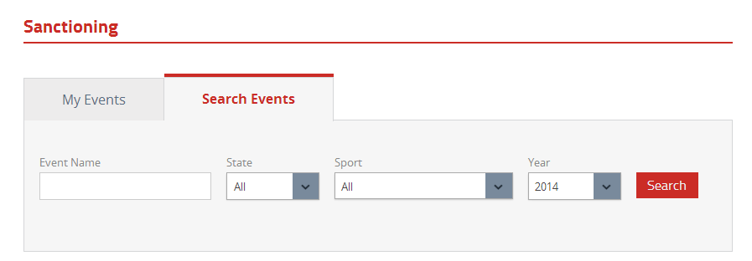
Searching for events online at www.nfhs.org
To search for a sanctioning event, go to www.nfhs.org, click on “Resources” in the top Navigation bar, then click on “Sanctioning”, then “Search Events” by typing the Event name, click on the drop down menu for the State (where event will be held), Sport, and school year. Then click on “Search.”

Slide 41
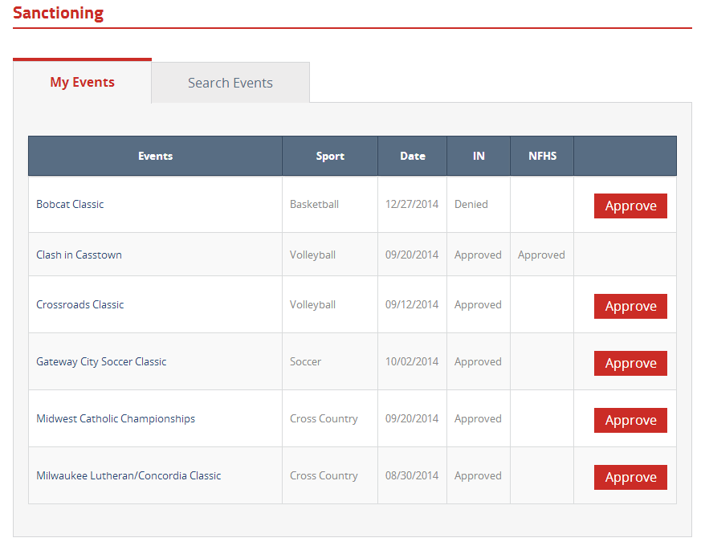
Posted Sanctioning e events
Once submitted, the list of events and their status become available to view.

Slide 42
Frequently Asked Questions?
Will we receive a hard copy of our event’s final approval?
  Yes, you will be able to print out the NFHS confirmation email advising you regarding the event’s approval or you can print the approval screen from the NFHS website.

Slide 43
Frequently Asked Questions?
What if I need to speak to a person for guidance regarding this online process?
  We understand that there will be some questions regarding the online process. If you have any procedural questions, please feel free to contact the NFHS Sanctioning Department at (317) 972-6900 for assistance Monday-Friday, 8:00 a.m.- 4:30 p.m. EST.

Slide 44
Thank you for reviewing the NFHS Online Sanctioning Process
Please feel free to contact the NFHS Sanctioning Department at (317) 972-6900, Monday-Friday, 8:00 a.m.- 4:30 p.m. EST.

