Slide 1
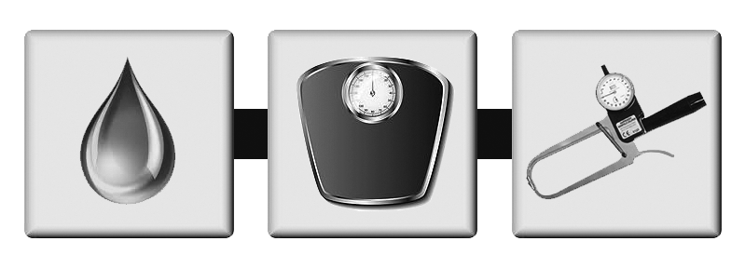
Wrestling Weight Monitoring Assessor Program
Michigan High School Athletic Association
1661 Ramblewood Drive - East Lansing, MI 48823

Slide 2
Primary Michigan
Wrestling Weight Monitoring Personnel
Michigan High School Athletic Association
dan@mhsaa.com or jamie@mhsaa.com
(517) 332-5046
Notes:
WELCOME! → Wrestling Weight Monitoring Assessor Program
Explanation… (RED: Stop, GREEN: Go, YELLOW: Slow Down)
Our contact information

Slide 3

In-Service Content
Introductions and Agenda
Components of the WWMP
  wrestling weight monitoring program
Body Composition Assessment
Procedure for “Alpha Weigh-In”
DAN
jamie
Notes:
HOUSEKEEPING
Turn on VIDEO - Display your NAME ( . . . )
MUTE when not sharing - Q’s → CHAT
BREAK ½ way → Don’t log out!
Hopefully no longer than 2 hours.
BREAKOUT (INTRO) & POLL (School Size)
Intros: 1) Name 2) Position 3) School (if any) 4) Interesting fact about you…
ALPHA ORDER → Staff Starts
TODAY: Introductions and Agenda
Components of the WWMP: wrestling weight monitoring program
Body Composition Assessment
Procedure for “Alpha Weigh-In”

Slide 4

In-Service Content
Changes from last year
Q & A
LAB: practical assessment of athletes
Test and Evaluation
Notes:
- JV will send test info, which will be online.

Slide 5
REMINDERS
Wrestlers are allowed to compete at their approved lowest minimum (competitive) weight during an appeal for a lower weight.
Wrestlers are allowed to begin losing 1.5% immediately following the Alpha Weigh-In. It does not matter if they plan to appeal or not.
Established: JANUARY 15th as the LAST date for hydrostatic/DXA appeals.
Established: 48-hour “wait period” for all wrestlers that FAIL the specific gravity test for both skinfold AND hydrostatic/DXA assessments and appeals.
Wrestlers MUST participate in “Skinfold” assessment FIRST!
They may NOT be assessed using Hydro or DXA to start.
9 / 13 / 48
Notes:
Wrestlers are allowed to compete at approved lowest minimum (competitive) weight during appeal.
Allowed to begin losing 1.5% immediately.
JAN 15th → LAST date for hydro/DXA appeals.
48-hour “wait period” for all wrestlers that FAIL the specific gravity.
“Skinfold” 1st! NO Hydro or DXA to start.

Slide 6
Healthy Training
Emphasis should be placed on training, NOT weight loss
Emphasis on lifelong healthy living
Consequences of dehydration

Slide 7

Training the Coach
Basic concepts of Weight Management
and Nutritional Guidelines
Seminar to educate the coaches on healthy eating habits,
safe weight-loss techniques and dangers of improper weight-loss.
Notes:
Basic concepts of Weight Management & Nutrition
Seminar materials to help!

Slide 8
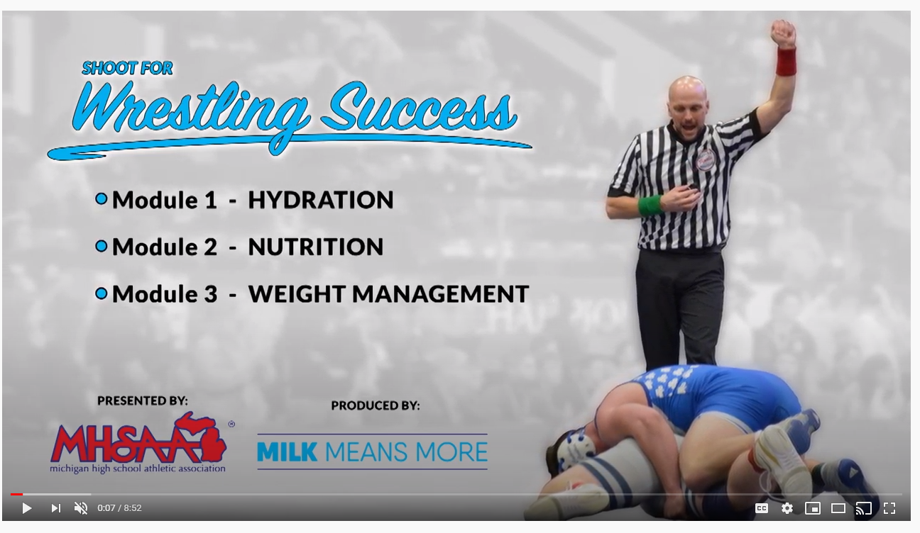
Educating the Athlete & Parent
Video
Individual program presentations
Web based Nutrition &
Weight Management program
Notes:
Program presentations (ATC?)
Web based materials
Video (NEW)

Slide 9


Why the Michigan Wrestling
Weight Monitoring Program?
Safe Participation
Healthy Athletes
Best Practices

Slide 10

American Medical Association - 1972
Position on weight-loss in wrestling
Advising against dehydration to “make weight”
Warning against food restriction

Slide 11

American College of Sports Medicine - 1976
Position paper on making weight in wrestling
Advised against the use of
dehydration, sauna, and heat to lose weight
Notes:
NO dehydration, sauna, and heat
FSU Weight loss system

Slide 12

Components of the Program
Nutrition Education Program
Regulations
Assessor In-Service

Slide 13




Regulation – Body Fat Limits
Skinfold assessment in HYDRATED state
Minimum of 7% - males
Minimum of 12% - females
5

Slide 14
Skinfold Assessor In-Service
Program For Wrestling
Weight Monitoring Assessors
Notes:
Skinfold Assessor In-Service

Slide 15
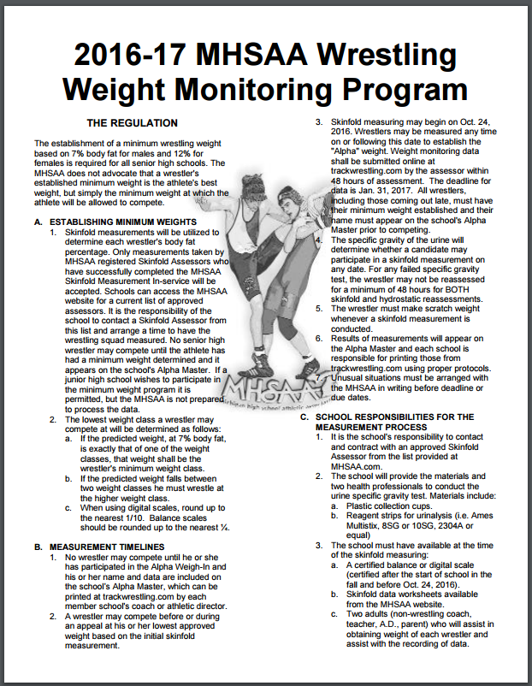
Skinfold Assessor In-Service
2017-18
Knowledge of MHSAA WWMP
Professional judgement
Valid assessment of body composition
for wrestlers
1st Day of Assessment: 10-20-25
33
Notes:
“Wrestling Weight Monitoring Program” – BLUE FORM
Knowledge of MHSAA WWMP
Professional judgement
Valid assessment of body composition
1st Day of Assessment: 10-20-25

Slide 16


Assessor Candidate Eligibility
Physicians, MD or DO
Physicians Assistant
Nurse Practitioner
RN, LPN
Certified Athletic Trainer
Physical Therapist
Nutritionist
Health Educator, Exercise Physiologist
Notes:
Most skinfold assessors are Athletic Trainers…
ROCK STARS!
Joe Ewald (Drew’s elbow…)

Slide 17
Training the Skinfold Instructor (cont’d)
Produce professional skinfold assessors
Experience and background check
Theory and practical exposure
Required registration fee
Notes:
Small fee to be an assessor
Easily make it back if you charge to do assessments.

Slide 18
Responsibilities: Skinfold Assessor
Program For Wrestling
Weight Monitoring Assessors
Notes:
Responsibilities: Skinfold Assessor

Slide 19

Roles & Responsibilities: Skinfold Assessor
Providing a service to member schools
of the MHSAA
Model for young athletes
Regard for “right to privacy”
(HIPAA / FERPA)
Confidentiality of information
Notes:
Be sure you don’t violate HIPPA or FERPA laws.
HIPAA: Health Insurance Portability and Accountability Act
FERPA: Family Educational Rights and Privacy ACT

Slide 20
Responsibilities: Skinfold Assessor
Maintain current registration
Contract with school prior to Alpha Weigh-In
Fee for service: no more than $6.50 per athlete
Arrive Early
Enter data online (www.trackwrestling.com) using your assessor password
Serve as the resident “expert”
Encouraged to “stay current”
12
Notes:
MUST be registered with the MHSAA.
Stay “CURRENT”.
If you miss a year, need “Face to Face” (zoom) meeting again.

Slide 21
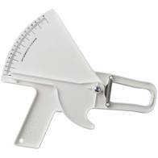
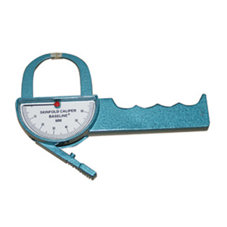
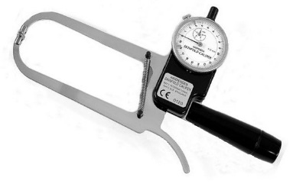
Responsibilities: Skinfold Assessor
Lange or Harpenden skinfold calipers
Assess and record each of the three (3) measurements to the nearest .5 mm,
for each site
GREATER than 3 mm difference are INVALID and the subject will need to be remeasured no sooner than 48 hours after
Record skinfold measurements for data entry
8 / 51 / 54
Notes:
Typically Lange or Harpenden calipers.
Let us know if you are using something different.
(3) measurements to the nearest .5 mm
Measurements greater than 3 mm difference will be returned.

Slide 22
Responsibilities: Skinfold Assessor
Check all worksheets for accuracy BEFORE entering data online.
If more than one (1) assessor is involved, make sure each wrestler is being entered online under the specific assessor’s username and password that assessed that wrestler.
46
Notes:
Check worksheets for accuracy BEFORE entering online.
If more than (1) assessor is involved, make sure EACH wrestler is being entered online under the specific assessor’s username and password that assessed that wrestler.

Slide 23
Responsibilities: Participating School
Program For Wrestling
Weight Monitoring Assessors
Notes:
Responsibilities: Participating School

Slide 24
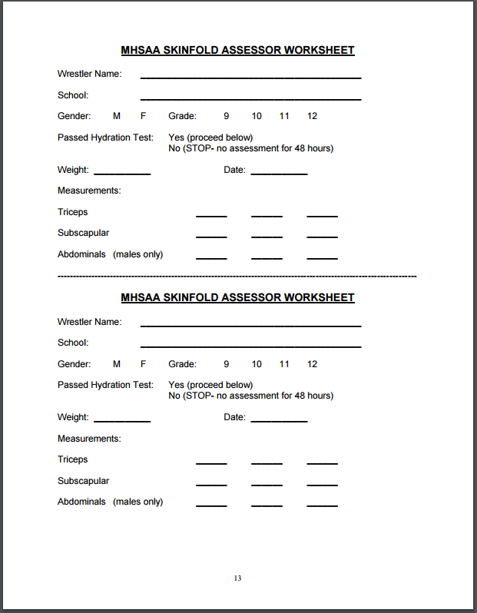
Responsibilities: Participating School
Complete data worksheets
last page: “Skinfold Assessor Handbook”
except for specific gravity and skinfold data
Ensure that wrestlers are on time and
prepared for assessment
Notes:
- WORKSHEET: Last page of “Skinfold Assessor’s Handbook”.

Slide 25

Responsibilities: Participating School
Contact a REGISTERED skinfold assessor
Provide adult volunteers (preferably five) for:
  1. Check-in Wrestlers (paperwork)
  2. Specific Gravity (health professional)
  3. Weigh-In
  4. Skinfold Measurement Recording
  Wrestling coaching staff EXCLUDED from ANY testing responsibilities
  or data entry
22 / 55-57 / 58-60
Notes:
SCHOOLS:
Contact a REGISTERED skinfold assessor
Provide adult volunteers (preferably five) for:
1. Check-in (paper work)
2. Specific gravity (health professional)
3. Weigh-in
4. Measurement recording
Wrestling coaching staff is EXCLUDED from ANY testing responsibilities or data entry

Slide 26
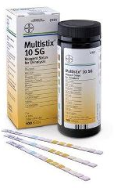
Responsibilities: Participating School
Purchase: Bayer Multistix 10SG (#2161)
Supply weight monitoring “Data Forms” provided by the MHSAA
Pens/Pencils
Certified scales used for the “Alpha Weigh-In”
(balance scales recorded up to nearest ¼ lb; digital 1/10 lb)
10 / 11
Notes:
SCHOOLS PROVIDE:
Multistix (VERIFY)
“Data Forms” (MHSAA online)
Pens/Pencils
Certified scales
balance scales → nearest ¼ lb;
digital 1/10 lb

Slide 27
Responsibilities: Participating School
Prepare wrestlers for Alpha Weigh-In:
  Undergarments (singlet) / loose shorts & t-shirt
  Collection cups
  Secure private, controlled area for specific gravity assessment
Remind schools wrestlers MUST participate in “Skinfold” assessment 1st!
They may NOT be assessed using Hydro or DXA to start.
6
Notes:
SCHOOLS:
Prepare wrestlers for Alpha Weigh-In:
Undergarments (singlet) / loose shorts & t-shirt
Collection cups
Secure private, controlled area for specific gravity assessment
Remind: “Skinfold” assessment 1st!
NO Hydro/DXA to start.

Slide 28
Responsibilities: Participating School
FEE guidelines
LIMIT: $6.50 per student
Fewer than six (6) wrestlers assessed on single date, one (1) site, assessor permitted to charge mileage at current IRS rate
OR $40.00 service fee
32
Notes:
FEE guidelines
LIMIT: $6.50 per student
Some ATC’s this is part of your job through the school contract.
Fewer than six (6) on single date, one (1) site, assessor permitted to charge mileage at current IRS rate OR $40.00 service fee
This may be the case when an assessor has to “re-test” a few wrestlers.

Slide 29
Responsibilities: MHSAA
Program For Wrestling
Weight Monitoring Assessors
Notes:
Responsibilities: MHSAA

Slide 30

Responsibilities of the MHSAA
Prepare and register skinfold assessors
Work w/ TrackWrestling in monitoring the
website and entry of data
Administrate all aspects of the hydro/DXA appeal process
Notes:
MHSAA RESPONSIBILIES:
Prepare/register assessors (TODAY)
Work w/ TrackWrestling in monitoring website & data
Administrate all aspects of the hydro/DXA appeal process

Slide 31
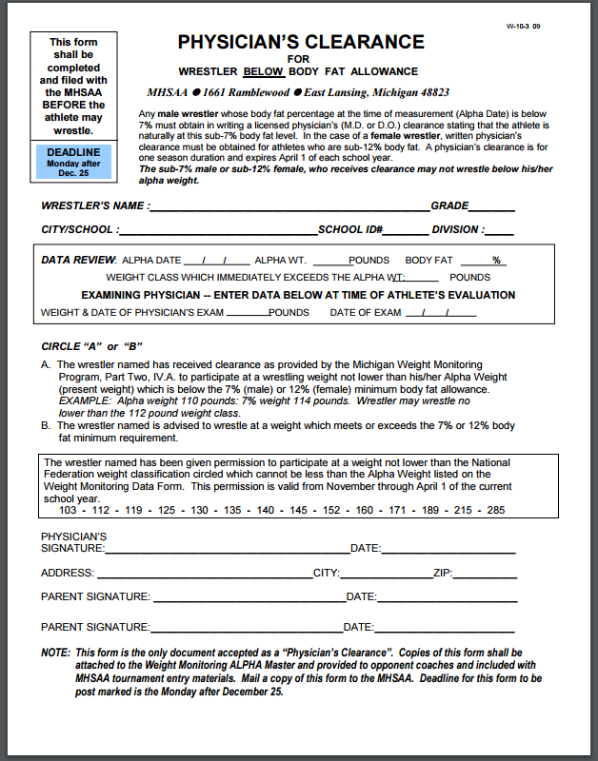
Responsibilities of the MHSAA
Maintain a file of hydrostatic/DXA assessments
Maintain a file of “Physicians Clearance”
  May not wrestle until clearance
  has been received and marked
  by the MHSAA.
Field calls from assessors & wrestling coaches pertaining to WWMP
Sub
7% or 12%
34
Notes:
MHSAA:
Maintain a file of Hydro/DXA assessments
Maintain a file of “Physicians Clearance”
May NOT wrestle until clearance has been received/marked by MHSAA.
Field calls from assessors & coaches

Slide 32
HYDRATION
Program For Wrestling
Weight Monitoring Assessors
Notes:
HYDRATION

Slide 33
Hydration Requirement
Athletes MUST be in a proper state of hydration to
determine their correct alpha weight
Students may NOT exercise before the Alpha Weigh-In
Specific gravity assessment of the urine will determine whether
the wrestler may participate in the skinfold measurement process
31
Notes:
MUST be hydrated.
NO practice before ALPHA.

Slide 34
Hydration Requirement
This is simply a PASS / FAIL assessment
Specific gravity >1.025g/ml is a FAILED test
“Alpha Weigh-In” must be conducted before the athletes participate
in that day’s practice or conditioning
No sweaty (and possibly dehydrated) athletes!
7 / 31
Notes:
This is simply a PASS / FAIL assessment
Specific gravity LESS than 1.025 → FAILED
Alpha must be done before participate in that day’s practice or conditioning
No sweaty (and possibly dehydrated) athletes!

Slide 35

Specific Gravity Assessment Procedure
Product Used:
  Bayer Multistix 10S (#2161)
  Make sure they include Specific Gravity Band #4
  Check expiration date!
  Store in cool, dry place
Other Supplies Needed:
  Latex Free Gloves
  Collection Cups
  Biohazard Bags
Notes:
Product Used:
Bayer Multistix 10S (#2161)
Must include Specific Gravity Band #4
Check expiration date!
Store in cool, dry place
Other Supplies Needed:
Latex Free Gloves
Collection Cups
Biohazard Bags

Slide 36
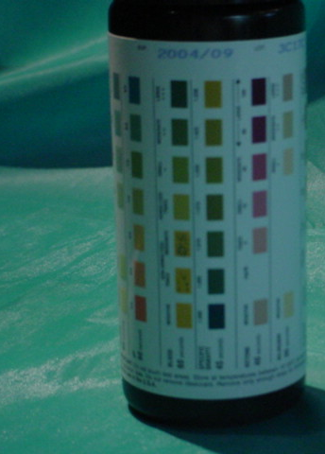
Check expiration date at the top of label
DO NOT USE
expired product

Slide 37
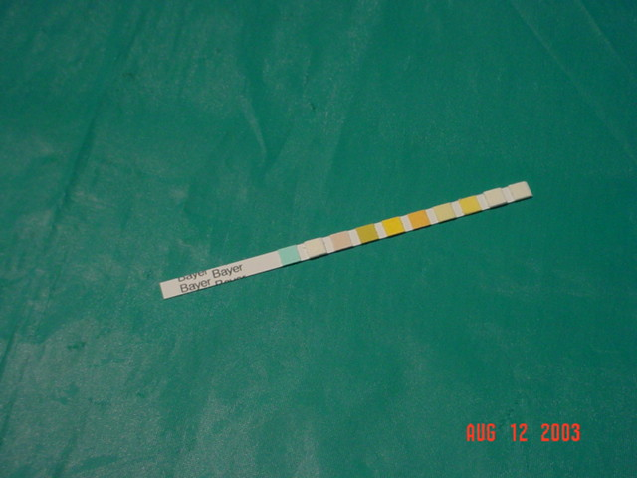
It is helpful to cut off squares up to Specific Gravity section (“olive” section) to make dipping and reading easier
CUT HERE
Hydration—Specific Gravity Band
Notes:
Cut Multistix between bands #4 & #5.
We are only looking for PASS / FAIL.

Slide 38
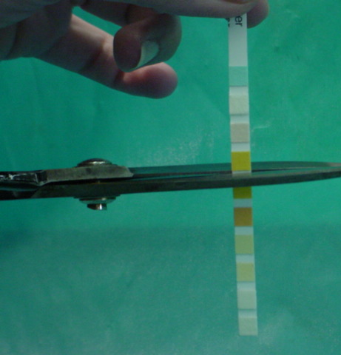
This is the only band we will focus on
Simplify the process!
Cut the strip between band four (4) & five (5)

Slide 39
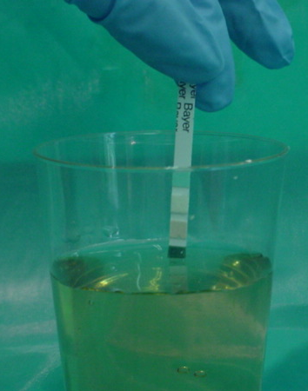
Dip Multistix and immediately remove from urine
Notes:
Have student provides their sample in a cup
Hand them a test strip for them to dip in their urine and hold while we observe and wait for the color to present.
The only time assessor might touch the strip is if we are having to look closely at the color if it is borderline fail.
The student then takes the cup and dumps out their sample in the toilet and flushes and washes.
So real limited contact with the urine overall.

Slide 40

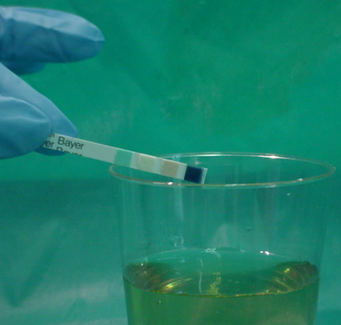
a. Wipe excess urine
on rim of container
b. Air dry for 45 seconds
c. Match band color
with gravity band on bottle
27
Notes:
a. Wipe excess urine on rim of container
b. Air dry for 45 seconds
c. Match band color with gravity band on bottle

Slide 41
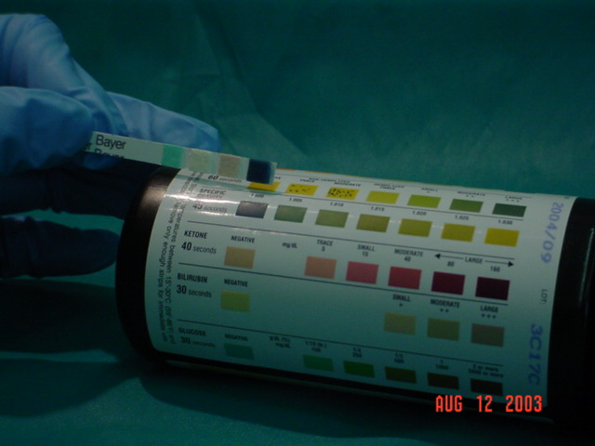
Compare the Multistix
with the specific gravity band on the bottle
Simply looking for
PASS / FAIL
Must Read <1.025
7
Notes:
REMEMBER:
Simply looking for PASS / FAIL

Slide 42


Specific Gravity Assessment Procedure (cont’d)
Instruct athletes to drink 6-10 glasses of water daily for 2-3 days
PRIOR to this test
Don’t go overboard w/ water the “day of” (may throw off actual weight)
Avoid beverages high in caffeine
Instruct athletes to urinate at least 1-2 times
during the day PRIOR to this test to prevent urine
from becoming too concentrated
15
Notes:
Reminder: Don’t go over board as it may throw off their actual weight for weigh-ins.
Drink 6-10 glasses of water daily for 2-3 days PRIOR to test
Don’t go over board with water the “day of” as it may throw off actual weight.
Avoid beverages high in caffeine (DEHYDRATED)
Instructed to urinate at least 1-2 times during the day PRIOR to this test to prevent urine from becoming too concentrated

Slide 43
Specific Gravity Assessment
School volunteers control the environment
Provide collection cup for one athlete at a time
Athletes enter a secured area, one at a time
Athlete collects a midstream sample & holds OWN specimen during test
Notes:
REMINDER:
Have student provides their sample in a cup
Hand them a test strip for them to dip in their urine and hold while we observe and wait for the color to present.
The only time assessor might touch the strip is if we are having to look closely at the color if it is borderline fail.
The student then takes the cup and dumps out their sample in the toilet and flushes and washes.
So real limited contact with the urine overall.

Slide 44
Specific Gravity Assessment
Test: Dip Multistix and remove immediately holding horizontally
Hold horizontal, wait 45 seconds and then compare to color strip
Continue with skinfold assessment if SG <1.025 (passing)
NO weight or skinfolds if SG >1.025
Athlete: empty cup in toilet, cup in waste receptacle
25

Slide 45
Technical Information & ASSESSMENT
Program For Wrestling
Weight Monitoring Assessors
Notes:
Technical Information & ASSESSMENT

Slide 46
Body Composition Prediction Methods
Bioelectric Impedance - Analysis (BIA)
Skeletal Anthropometric - Widths (SAW)
Near Infa-Red (NIR)
Computed Tomographs (CT scan)
Bod Pod
Hydrostatic Weighing (HW)
Skinfold Assessment (SF)
Notes:
Lots of other ways…
Better but EXPENSIVE
IMPERFECT FOR ALL!

Slide 47
Body Composition Prediction Methods
Comparison of Methods Considerations
    Cost
    Availability
    Time
    Validity
    Reliability
    Why Skinfold Assessment?
The degree to which an assessor obtains an accurate measure of the skinfold site
29 / 30
Notes:
Validity
The degree to which an assessor obtains an accurate measure of the skinfold site

Slide 48
Body Composition Prediction
Skinfold Assessment Terminology
    Total Body Weight (TBW)
    Body Density (BD)
    Mass of the body per unit volume
    Lean Body Mass (LBM)
    Percent Body Fat (%BF)
3
Notes:
Body Density (BD):
Mass of the body per unit volume

Slide 49
Body Composition Prediction
Lean Body Mass (LBM)
Muscle & bone mass predicted to be in the body
    Muscle mass
    Bone mass
    Provides for activity
    Support structure
    Use and production of blood
1
Notes:
LBM: Lean Body Mass
Muscle & bone mass predicted to be in the body

Slide 50
Body Composition Prediction
Body Fat = (BF)
Essential & non-essential fat storage predicted to be in the body.
    Essential fat
    Non-essential fat
    Insulates
    Padding for organs
2
Notes:
Body Fat = (BF)
Essential & non-essential fat storage predicted to be in the body.
End of the day, we are looking for → Lowest Minimum Weight

Slide 51
Body Composition Prediction
Skinfold Assessment Terminology (cont’d)
    Fat Weight (FW)
    The weight of essential & non-essential fat in the body
    Minimum Wrestling Weight (MWW)
    Optimal Body Weight (OBW)
4
Notes:
Fat Weight (FW)
The weight of essential & non-essential fat in the body

Slide 52
Body Composition Prediction
Skinfold Assessment Terminology (cont’d)
    Minimum Weight
    Regression Equation(s)
    Population Specificity
    Biological Variability
    Technical Variability
    Reliability
    Validity
The attempt to make prediction calculations on representative subjects from a specific group of individuals leads to the formation of a…
14
Notes:
The attempt to make prediction calculations on representative subjects from a specific group of individuals leads to the formation of a:
Population Specificity

Slide 53

Skinfold Assessment Standards
Standard Instruments
    Caliper standard
      Lange or Harpenden
    Site Location
    Scale Certification
    Standard Hydration
8
Notes:
Caliper standard:
Lange or Harpenden

Slide 54
Conducting the “Alpha Weigh-In” (the Stations)
1. Data completion form
2. Hydration status –
specific gravity of urine
3. Weight
4. Skinfold measurement verification
5. Data verification & entry
Assistant may fill in name, school, gender and grade portions…
Notes:
Data completion form
Assistant may fill in name, school, gender and grade portions…
Boys below 7%, Girls below 12% → “Physicians Clearance” form to the MHSAA.
You will have a good idea as soon as you pinch all sites → Give a “Heads Up”

Slide 55
Skinfold Assessment Standards
Site Selection and Identification
    Anatomical Position
    RIGHT Side Assessment
    Site Identification
      Triceps
      Subscapular
      Abdominal
    Site ROTATION across sites
TRI | 1 | 4 | 7
SUB | 2 | 5 | 8
ABD | 3 | 6 | 9
TRI | 1 | 3 | 5
SUB | 2 | 4 | 6
ABD | X | X | X
28
Notes:
Site Selection & Identification
Anatomical Position
RIGHT Side Assessment
Tri
Subscap
Abdominal
ROTATE across sites

Slide 56
Skinfold Assessment Standards: Transgender
The Weight Monitoring Program or “skinfold” process which determines a wrestler’s lowest minimum weight has the student’s health & safety at the forefront. This process is based on gender biology as opposed to gender identification.
Females who identify as males will be assessed as females in order to keep the student healthy and safe with a body fat level not to be below 12%.
A student who identifies as a gender other than the one on their birth certificate and has begun hormone therapy and has additional supporting documentation (driver’s license, school records, physical form, etc.), may make a request to the MHSAA to be assessed using their identified gender’s requirements in regard to the skinfold assessment.
Notes:
TRANSGENDER:
Program has the student’s health & safety at the forefront.
Process is based on gender biology as opposed to gender identification.
Females who identify as males will be assessed as females in order to keep the student healthy and safe with a body fat level not to be below 12%.
Begun hormone therapy & supporting documents (license, school records, physical, etc.), may request to the MHSAA to be assessed using identified gender.
Probably will not be a male wanting to be assessed as female. WHY?

Slide 57
Skinfold Assessment Standards
Sites
    Identify & mark sites (RIGHT)
    PALPATE (examine by touch, especially for medical purposes) site gently
    Elevate skinfold & fat under it
    Use thumb and index finger of LEFT hand
28 / 39 / 40
Notes:
STANDARDS:
Identify & mark sites (RIGHT)
PALPATE site gently
Elevate skinfold & fat under it
Use thumb & index finger of LEFT hand

Slide 58
Skinfold Assessment Standards
Skinfold Sites (RIGHT side – rotate across)
    Triceps = VERTICAL, posterior mid-way between the AC joint and elbow olecranon process and mid-way between the medial and lateral tissue of the triceps (|)
    Subscapular = DIAGONAL axis 1 cm below INFERIOR angle
    of scapula (\)
    Abdominal = VERTICAL, anterior 3 cm lateral &
    1 cm below the umbilicus (|)
Notes:
Sites (RIGHT side – rotate across)
Tris = VERTICAL, posterior mid-way between the AC joint and elbow olecranon process and mid-way between the medial and lateral tissue of the triceps (|)
Subscap = DIAGONAL axis 1 cm below INFERIOR angle of scapula (\)
Abdominal = VERTICAL, anterior 3 cm lateral & 1 cm below the umbilicus (|)

Slide 59
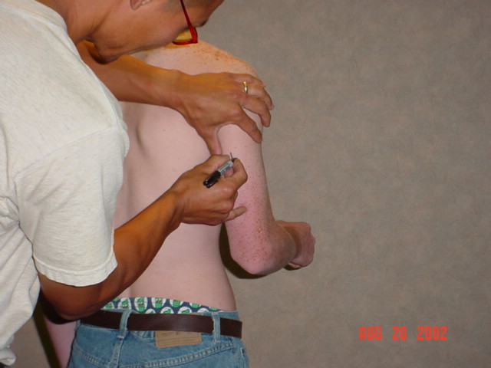
Assessment Standards
TRICEPS
VERTICAL
Posterior mid-way between AC joint and elbow olecranon process
Mid-way between medial and lateral tissue of triceps
36
Notes:
Tris = VERTICAL, posterior mid-way between the AC joint and elbow olecranon process and mid-way between the medial and lateral tissue of the triceps (|)

Slide 60
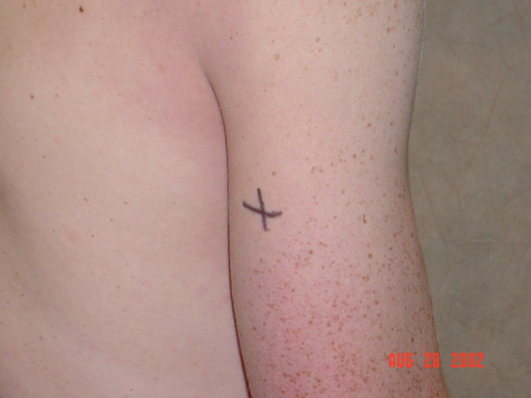
Assessment Standards
TRICEPS
VERTICAL
Posterior mid-way between AC joint and elbow olecranon process
Mid-way between medial and lateral tissue of triceps
36

Slide 61
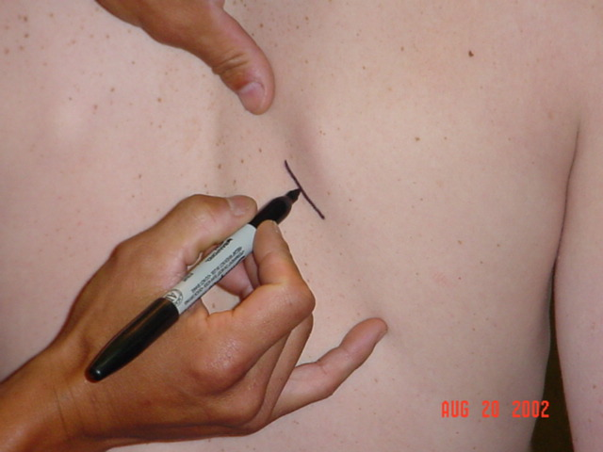
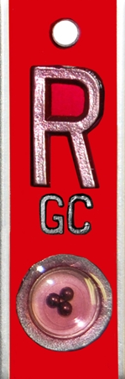
Assessment Standards
SUBSCAPULAR
Diagonal fold taken 1 cm
below the INFERIOR angle of the scapula
37
Notes:
Note: RIGHT SIDE
Subscap = DIAGONAL axis 1 cm below INFERIOR angle of scapula (\)

Slide 62
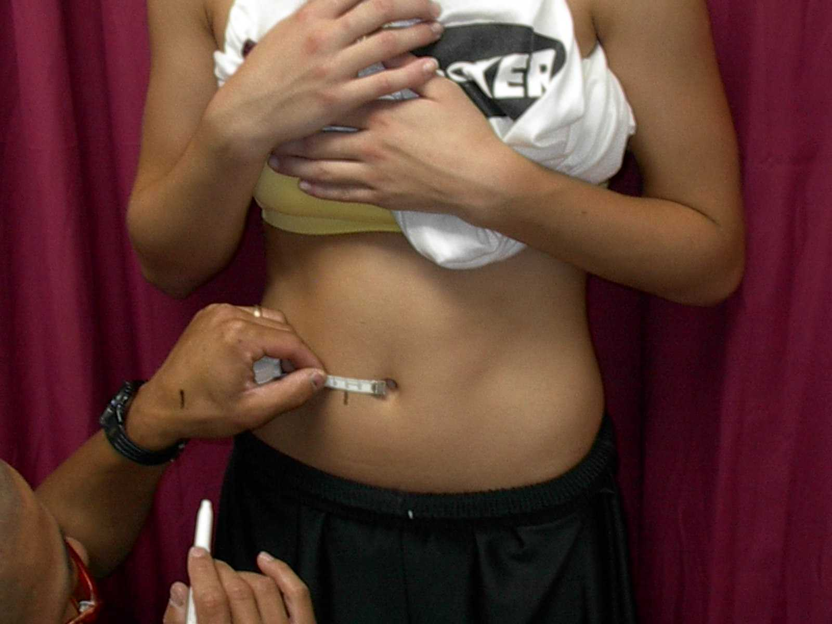

Assessment Standards
Measure & Mark
ABDOMINAL
  3 cm lateral to naval
  1 cm inferior
  VERTICAL fold
38
Notes:
Abdominal = VERTICAL, anterior 3 cm lateral & 1 cm below the umbilicus (|)
Pre cut a sheet (Jig) to save time.
Anything strange with this photo?
No abdominal reading for FEMALES (Only Tri and Subscap)

Slide 63
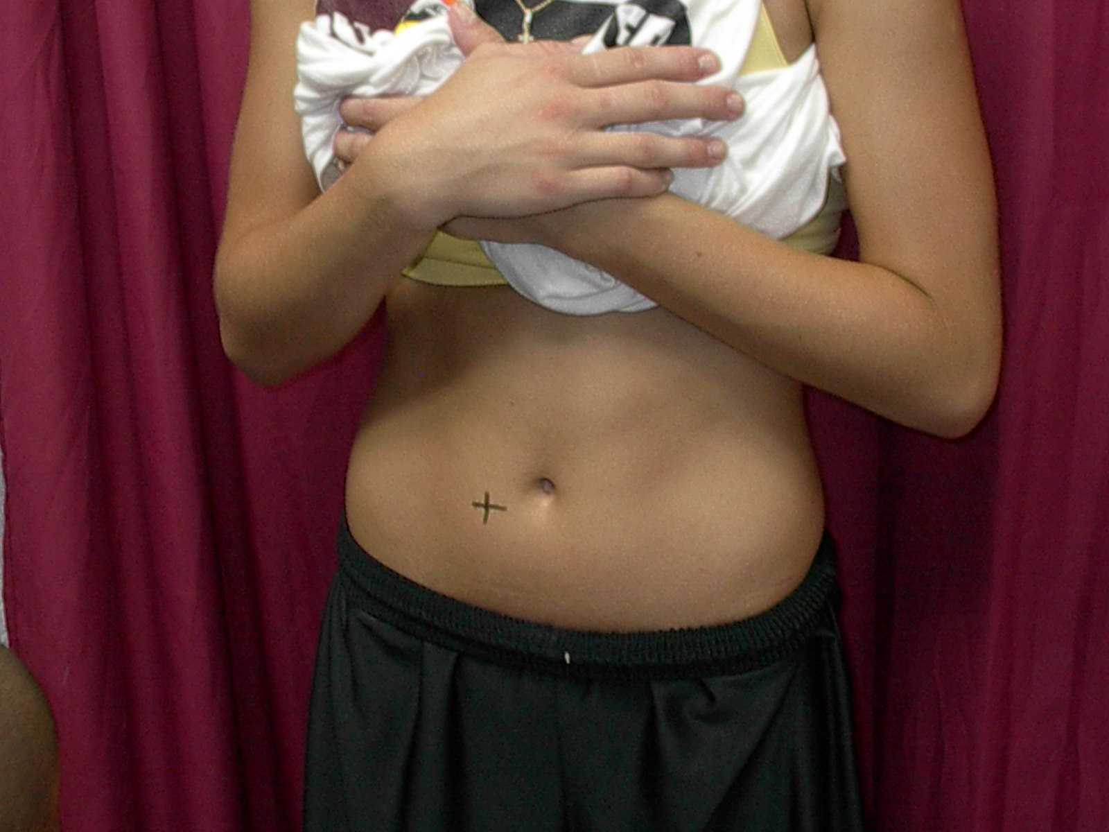
Assessment Standards
Site Determined
ABDOMINAL
  3 cm lateral to naval
  1 cm inferior
  VERTICAL fold
38

Slide 64
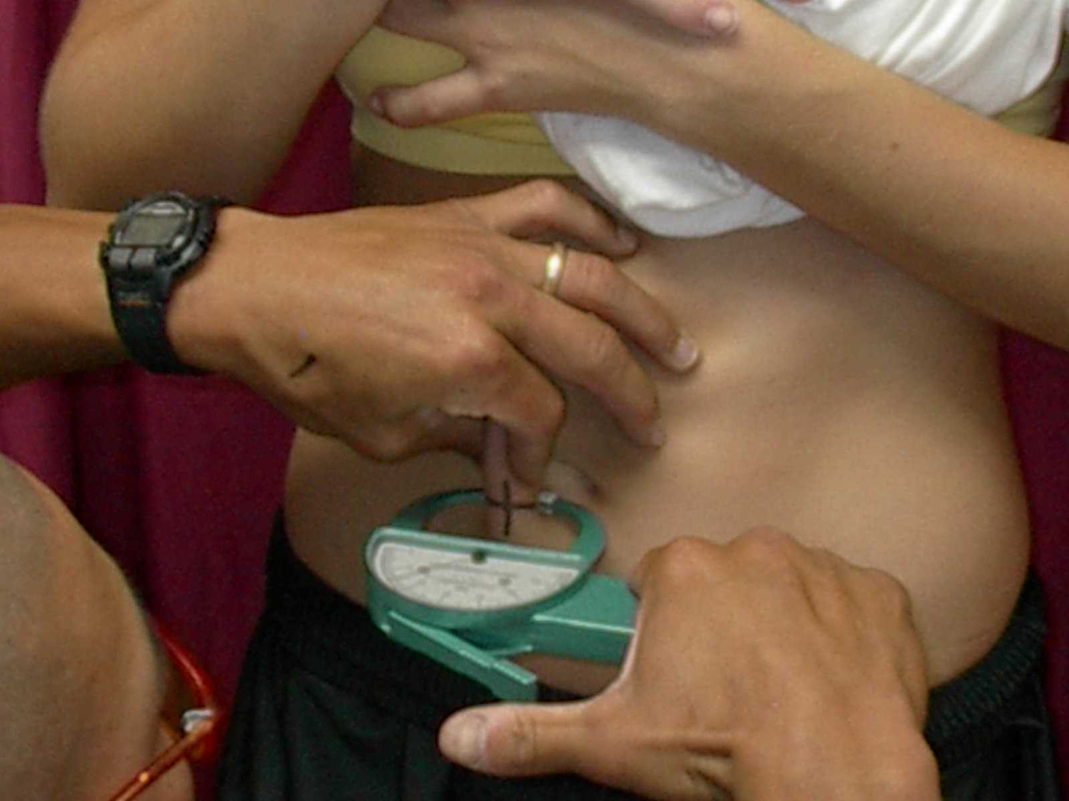
Assessment Standards
Pinch with LEFT hand VERTICALLY.
Caliper in RIGHT hand
BELOW Left hand
Measurement
ABDOMINAL
  3 cm lateral to naval
  1 cm inferior
  VERTICAL fold
38 / 40
Notes:
Pinch with LEFT hand (VERTICALLY).
Caliper in RIGHT hand BELOW LEFT Hand.

Slide 65
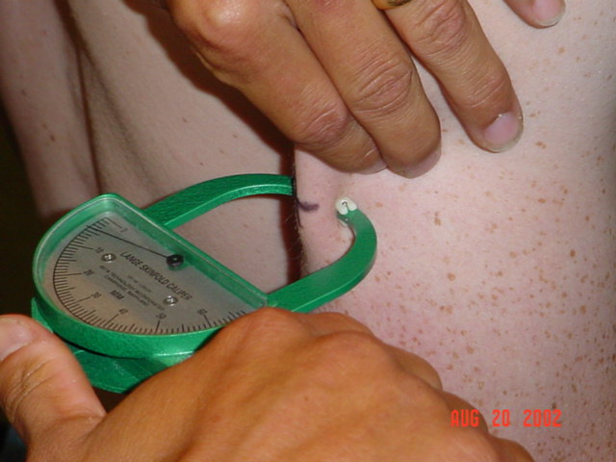
Assessment Standards
TRICEPS
Perpendicular Caliper
Orientation to site (+)
Parallel skinfolds
Calipers in RIGHT hand
42
Notes:
TRICEPS
Perpendicular Caliper
Orientation to site (+)
Parallel skinfolds
Calipers in RIGHT hand

Slide 66
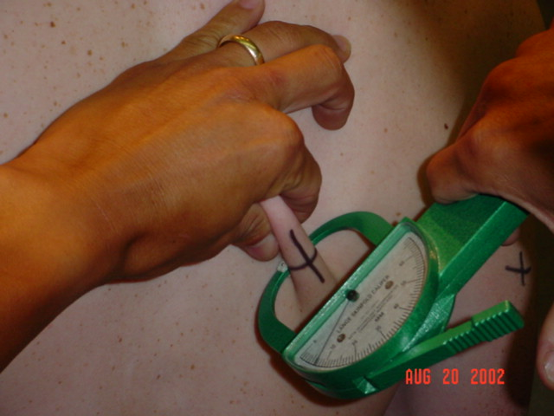
Assessment Standards
SUBSCAPULAR
Same mechanics (will not be vertical…)
Notes:
SUBSCAPULAR
Same mechanics (will not be vertical…)

Slide 67
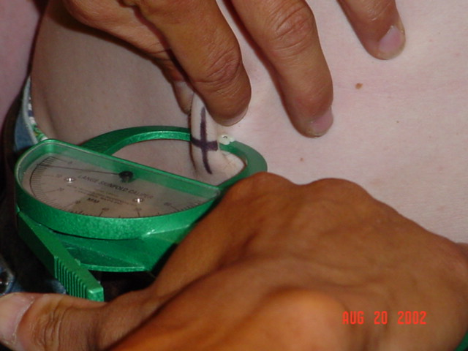
Assessment Standards
Avoid parallax error
by looking straight on
at the skinfold caliper’s
measurement scale
Follow natural cleavage
of skinfold
FYI: Parallax is a displacement or difference in the apparent position of an object viewed along two different lines of sight, and is measured by the angle or semi-angle of inclination between those two lines. The term is derived from the Greek word παράλλαξις (parallaxis), meaning "alteration".
Notes:
- Avoid parallax error by looking straight on at the skinfold caliper’s measurement scale
Parallax is a displacement or difference in the apparent position of an object viewed along two different lines of sight, and is measured by the angle or semi-angle of inclination between those two lines.
The term is derived from the Greek word παράλλαξις (parallaxis), meaning "alteration".

Slide 68
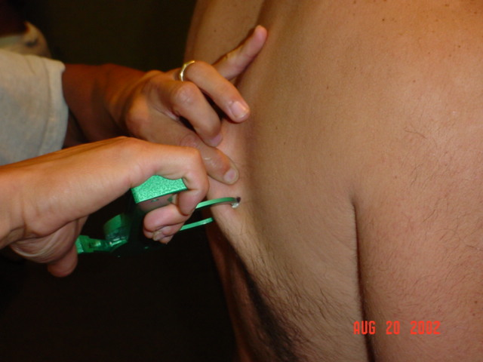
Assessment Standards
Caliper jaws placed midway between body and crest of skinfold
Caliper perpendicular to skinfold
Read caliper between 2-4 seconds after releasing thumb pressure from caliper while maintaining skinfold grasp
Get a good pinch!
43
Notes:
Caliper jaws placed midway between body and crest of skinfold
Caliper perpendicular to skinfold
Read caliper between 2-4 seconds after releasing thumb pressure from caliper while maintaining skinfold grasp
Get a good pinch!

Slide 69
Assessment Standards
Read measurement from caliper to the nearest 0.5mm
Have assistant record your measurements
ROTATE to next site
Return to SAME site to obtain subsequent
measures NOT greater than a 3mm variance
44
Notes:
Read measurement from caliper to the nearest 0.5 (half) mm
Have assistant record your measurements
ROTATE to next site
Return to SAME site to obtain subsequent measures NOT greater than a 3 mm variance . Variances greater than 3 mm at any one pinch site are invalid and the subject will need to remeasured no sooner than 48 hours after.

Slide 70

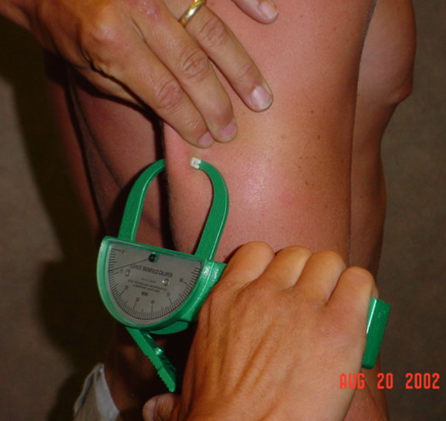
Assessment Standards
Improper Method!
Angle of calipers
(should be perpendicular)

Slide 71
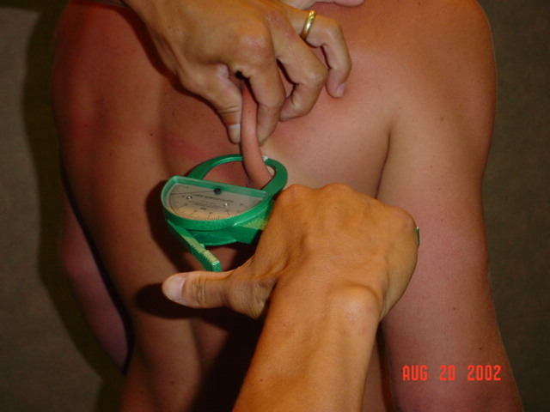
Assessment Standards
Improper Method!
Holding too long to read
(2-4 seconds)

Slide 72
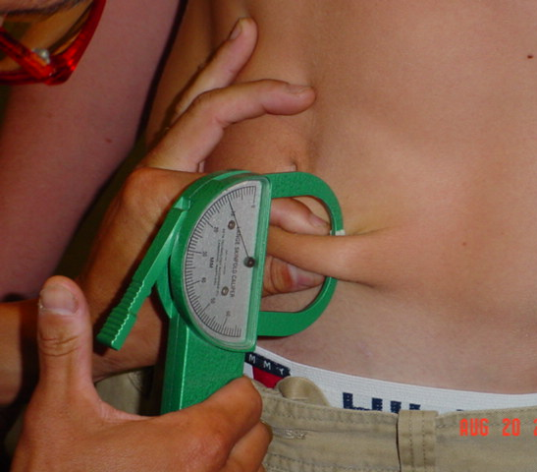
Assessment Standards
Improper Method!
Vertical measurement
Wrong Side of navel
Horizontal fold

Slide 73
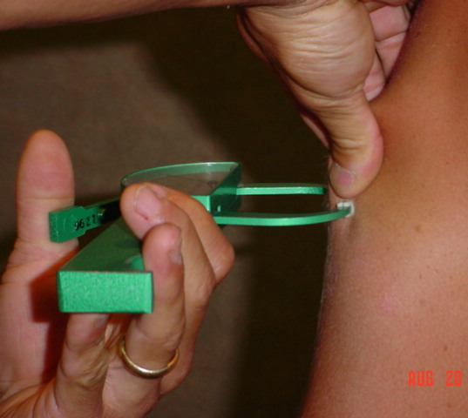
Assessment Standards
Improper Method!
Insufficient tissue
Caliper too close to thumb & index finger
Wrong hand
40 / 41

Slide 74
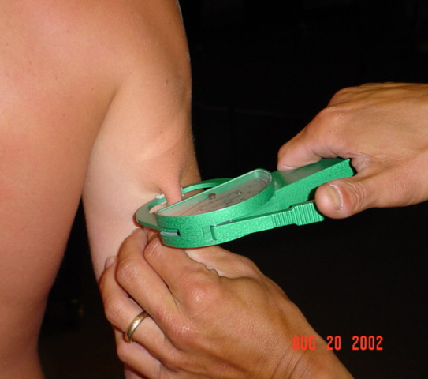
Assessment Standards
Improper Method!
Left hand BELOW calipers

Slide 75
Assessment Standards
Improper Method!
Vertical measurement NOT used for subscapular measurement.

Slide 76

Assessment Standards
    Differences GREATER than 3mm are INVALID
    Assessors will maintain all original data sheets in a secure location for one (1) calendar year
Notes:
REMINDER:
Differences GREATER than 3 mm are invalid and the subject will need to be remeasured no sooner than 48 hours
Assessors maintain all original data sheets in a secure location for one (1) calendar year

Slide 77
Skinfold Assessment Calculations
LOHMAN Equation for Body Density
BD= [1.0973 - (sumSFx.000815)]+[(sumSF)²x.00000084]
sumSF=TricepsSF+SubscapularSF+AbdominalSF
    (each skinfold value is an average of the three recorded)
    carry out calculations to five places past the decimal
    e.g. 1.08787

Slide 78
Skinfold Assessment Calculations
Brozek Equation for Body Fat from Body Density
% BF = (457 / BD) - (414.2)
    carry out calculations to two places past the decimal
    e.g. 12.34%

Slide 79
Skinfold Assessment Calculations: MALE
Minimum Wrestling Weight @ 7%
MWW = ([1-(%BF/100)] x TBW) / (.93)
Alternate method
    Fat Weight (FW) = TBW x (%BF/100)
    Lean Body Mass (LBM) = TBW - FW
    MWW = LBM / .93

Slide 80
Skinfold Assessment Calculations: FEMALE
Boileau Equation for %Body Fat
  %BF = [1.35 x (sumSF)] - [0.012 x (sumSF)²] - 3.4
  sumSF = Triceps SF + Subscapular SF
  (each skinfold value is an average of the three recorded)
MWW (females) = LBM / .88
Nicole is a female wrestler who also participated in the Alpha assessment on November 13 while weighing 132 pounds and had average skinfold measurements of
triceps: 11 and sub scapula: 12. Nicole’s percent body fat is…
12+11 = 23(sumSF) x 1.35 = 31.05 31.05 – 6.348 = 24.702 – 3.4 =
0.012 x (23x23 = 529(sumSF²) = 6.348 21.302 body fat %
132 lbs – 21.302 (BF) = 110.698 (LBM) / .88 = 125.79 lbs (Minimum Wrestling Weight)
20
Notes:
Test Answer:
21.302 body fat %

Slide 81
Skinfold Assessment Calculations: MALE
Sample Calculation For Male
    Triceps = 6, Subscap = 9.5, Abdominal = 9
    sum SF = 24.5
BD= [1.0973 - (24.5 x .000815)] + [(24.5)² x .00000084]
BD= 1.07783
%BF= (457/BD) - 414.2 = 9.8%
Steve is a wrestler who participated in the Alpha assessment on November 13 while weighing 123 pounds and had average skinfold measurements of triceps: 6, sub scapula: 9.5 and abdominal: 9. From this data, his lean body mass in pounds is…
1.0973 – 0.01996 = 1.07734 + 0.00050421 = 1.07783
457 / 1.07783 = 424.0 – 414.2 = 9.8% Body Fat
123 lbs / 9.8% = 12.55 lbs 123 lbs – 12.55 lbs = 110.4 lbs (Minimum Wrestling Weight)
19
Notes:
Test Answer:
110.4 lbs (Minimum Wrestling Weight)

Slide 82

The Appeal Process – Step 1
Reassessment by Original Assessor
Step1 may be bypassed and only Step 2 performed
Reassessment by SAME assessor
Completed within 14 days of “Alpha Weigh-In”
Reassessment data entered online by SAME assessor!
Includes reassessment of Hydration
Notes:
Appeal Process – Step 1
Reassessment by Original Assessor
Step1 may be bypassed and only Step 2 performed
Most advantageous to asses near the 14th day.
No EXTRA days! (Assessor “wedding”…)
Assesor may “enter” after the 14th day, but wrestler should not compete at the new weight until it goes through and is posted on Track.

Slide 83
The Appeal Process – Step 2
Hydrostatic/DXA Weighing
Hydrostatic/DXA Results are FINAL and BINDING
School files “Hydrostatic/DXA Weighing Proposal”
prior to testing
Hydro/DXA appeal ends JAN 15th.
Facilities approved by MHSAA (www.mhsaa.com)
Currently eight (8) facilities listed
MUST have at least ONE skinfold assessment PRIOR to this step.
Notes:
Appeal Process – Step 2
Hydrostatic/DXA Weighing
1 Skin Fold FIRST
Hydrostatic/DXA Results are FINAL and BINDING
Inform: 70% lower, 20% same, 10% UP!
School files “Hydrostatic/DXA Weighing Proposal” prior to testing
Hydro/DXA appeal ends JAN 15th.
Facilities approved by MHSAA (www.mhsaa.com)

Slide 84

The Appeal Process – Step 2
Hydrostatic/DXA/BodPod Weighing
Hydrostatic/DXA/BodPod Results are FINAL and BINDING
14-day appeal period starts on the day
following the original “Alpha Weigh-In” attempt
    1.5% weight reduction allowed days 1-14
Hydrostatic/DXA/BodPod weighing options end on JAN 15th!
35
Notes:
- 14 day appeal period starts on the day following the original “Alpha Weigh-In” attempt
1.5% weight reduction allowed days 1-14
Hydrostatic/DXA weighing option ends on JAN 15th!

Slide 85

TRACKWRESTLING: ONLINE PROGRAM
Upon successful completion of this course, MHSAA/TrackWrestling will email each assessor their user ID and password
ONLY the registered assessor shall input data
and use their ID and password
DO NOT SHARE YOUR PASSWORD WITH ANYONE!
Keep a hard copy (worksheets) for your records
(for one calendar year) and as a means of back-up
Worksheets are available at MHSAA.com
18
Notes:
Completion of course:
MHSAA/TW will email each assessor their user ID & password.
ONLY the registered assessor shall input data and use their ID and password.
DO NOT SHARE YOUR PASSWORD WITH ANYONE!
Keep hard copy (worksheets) for your records
1 calendar year (back up)
Worksheets are available at MHSAA.com.

Slide 86


Slide 87
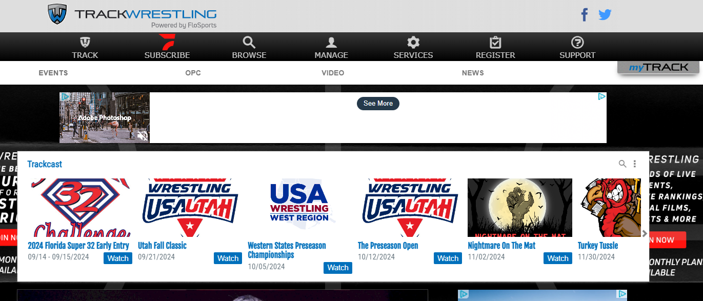
www.trackwrestling.com

Slide 88
Logging In
Assessor Login ID
Assessor Password
Provided by the
MHSAA & TrackWrestling upon completion of In-Service & Test
16

Slide 89

Click → OPC (Optimal Performance Calculator)

Slide 90
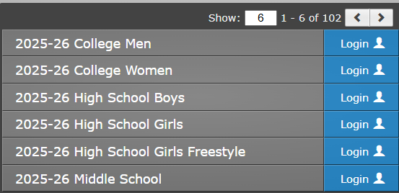
Login Page
Data for boys and girls will be entered in the Boys High School Season
Click “Login” beside 2025-26 High School Boys
Notes:
All data will be entered in the Boys Season (boys and girls).
All girls info should also be entered into the Girls Season

Slide 91
Login Page
Data for all girls should also be entered in both the Boys High School Season and the Girls High School Season.
Click “Login” beside 2024-25 High School Girls
Notes:
All data will be entered in the Boys Season (boys and girls).
All girls info will also be entered into the Girls Season

Slide 92
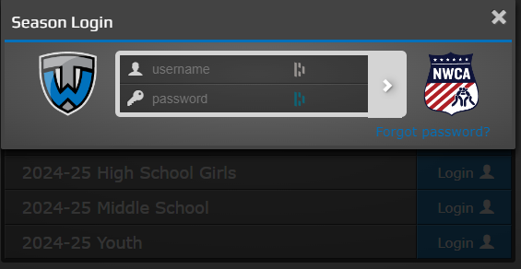
Login Page
Enter Username and Password
**These may be changed once you are logged in**

Slide 93
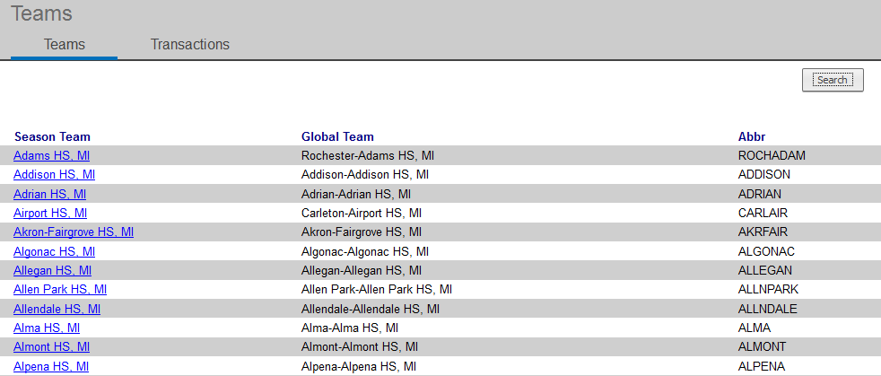
Assessor Dashboard
List of schools that you are able to assess will appear
Select here or search here
Notes:
You can also “SEARCH” here…

Slide 94
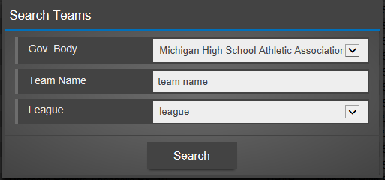
Select / Search School
Notes:
If you use “SEARCH”

Slide 95
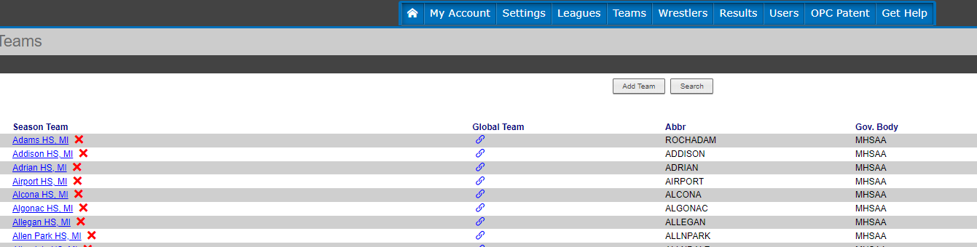
Select and Click on School

Slide 96

Entering Data
Name, Grade & Gender
Date of Assessment
Urine specific gravity
Alpha body weight
Skinfold measurements
Percent Body Fat (BIA)
Use TAB – (data computes automatically)
USE TAB KEY
17 / 47
Notes:
Entering Data:
Use the TAB key!

Slide 97
Female Wrestlers
Click on the “Add Female” wrestler link of the initial assessment Step 1.
ONLY the triceps and subscapular skinfolds will be entered
(for a total of six (6) measurements).
Minimal wrestling weight will be calculated at 12%.

Slide 98
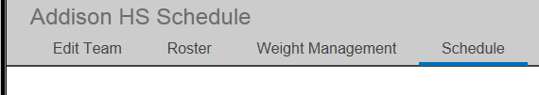
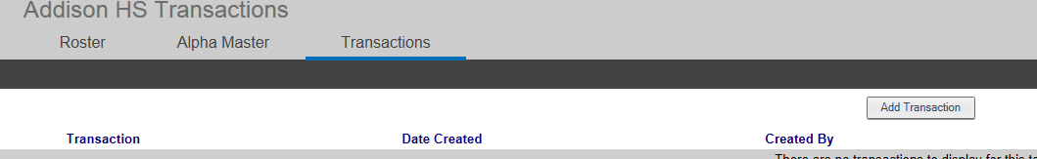
Entering Assessments
Select “Weight Management”
Then select “Add Transaction”

Slide 99
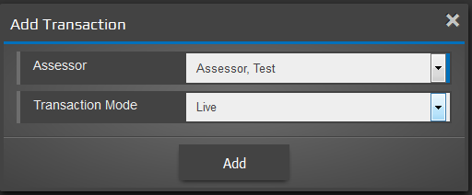
Entering Assessments
Confirm if “PRACTICE” or “LIVE” Transaction
Notes:
May change to “PRACTICE” if you so choose.
Reminder: Coach or AD may import last years roster.

Slide 100
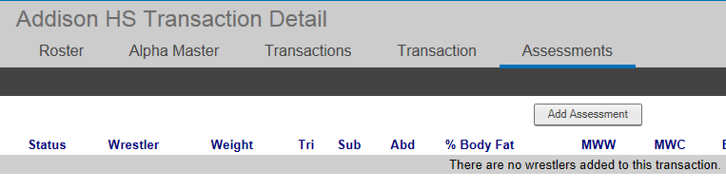
Assessment Form – Step 1
Click on “Add Assessment”

Slide 101
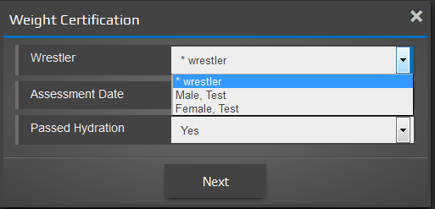
Assessment Form – Step 2
Select wrestler from the drop-down menu

Slide 102
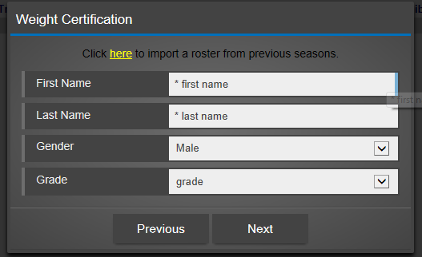
Assessment Form – Step 2
Coach or AD may import roster from previous year
Add new wrestler if not in the drop-down menu
Notes:
Assessors CANNOT import last year’s roster.
This is ONLY available to the coach or AD.

Slide 103
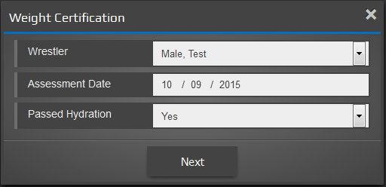
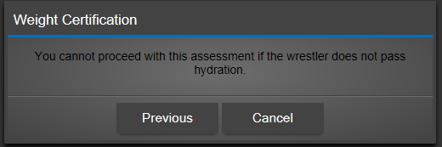
Assessment Form – Step 3
Enter assessment date and if passed hydration test
Pops up if wrestler has not passed hydration
Notes:
- Would not enter a wrestler that has not passes hydration.

Slide 104
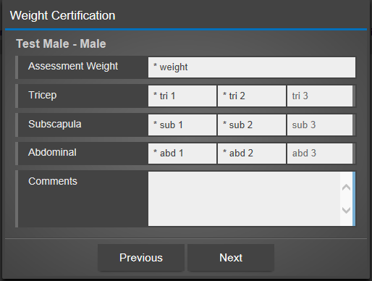
Assessment Form – Step 4
Is this a Male or a Female?
How do you know?
Enter body fat measurements
?
Notes:
You can tell this is a MALE as there are NINE (9) boxes.
FEMALES will only have SIX (6) boxes to mark.
TAB is the fastest way to move from box to box.

Slide 105
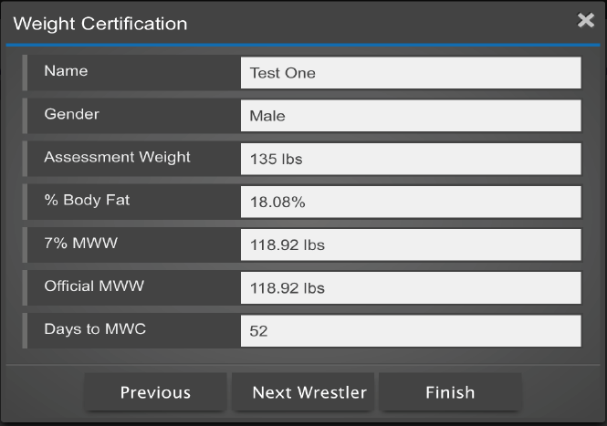
Assessment Form – Step 5
Calculations: Final Calculations – Click “Next Wrestler” or “Finish”
49

Slide 106
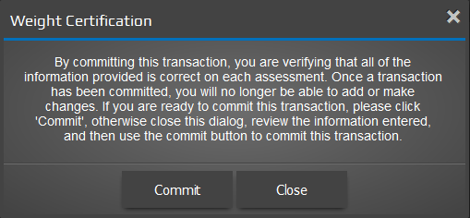
Assessment Form – Step 6A
Click on “Finish” when completing all assessments –
suggested to hit close to review assessments BEFORE committing
Notes:
- By “COMMITTING”, it basically means that you are not lying and truthful in regards to the data submitted.

Slide 107
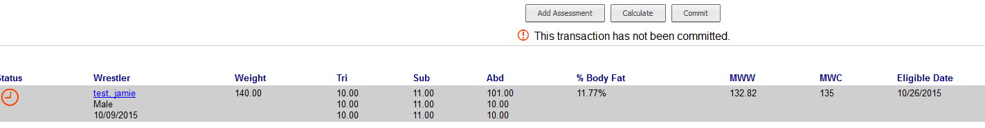
Assessment Form – Step 6B
Review assessments and then click on confirm – RED clock means pending – If there is an “error”, click on the wrestler’s name to edit the assessment PRIOR to confirming.
Notes:
RED clock means pending
If there is an “error”, click on the wrestler’s name to edit the assessment PRIOR to confirming.

Slide 108
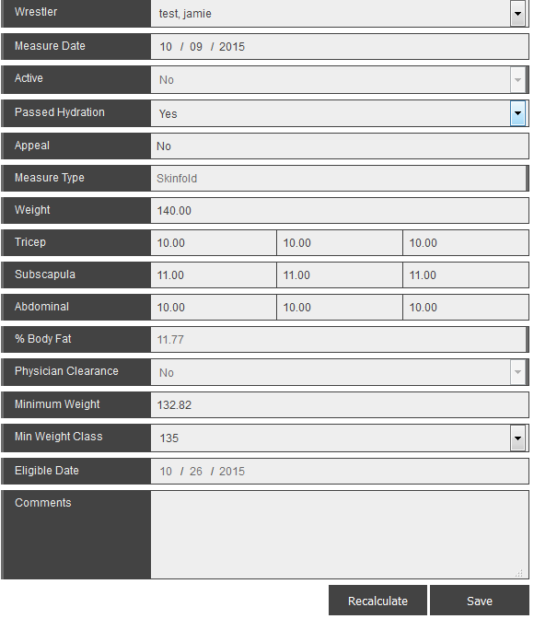

Assessment Form - Error
Edit the assessment form –
Click “save” and then recalculate

Slide 109

Assessment Form – Step 6C
Confirm “commit” transaction
This is the FINAL step to submit data
Notes:
- This is your FINAL step!

Slide 110

Assessment Form – Step 6D
Assessments are confirmed
Status turns to GREEN when confirmed
Notes:
- Status turns to GREEN when confirmed

Slide 111

Individual Weight Loss Plan
- Access from roster or alpha master report
- Click on “SCALE” Icon
- Coach or AD supplies information to the athlete.
45

Slide 112

Individual Weight Loss Plan

Slide 113

Alpha Master Report
coach prints
this form
50
Notes:
- This is the form the coaches share with one another.

Slide 114

Let’s Review
Remember:
    Plan Ahead
    Call Ahead
    School Provides Help
    Accuracy of Skinfolds
    Skinfold Assessment
    MAX - $6.50 per Athlete
    You will be the EXPERT!
Notes:
Remember:
Plan Ahead
Call Ahead
School Provides Help
Accuracy of Skinfolds
Skinfold Assessment
MAX - $6.50 per Athlete
You will be the EXPERT!

Slide 115
Michigan High School Athletic Association
1661 Ramblewood Drive - East Lansing, MI 48823
(517) 332-5046 www.mhsaa.com

